Slide 1
Sound Spatialization :: Fall 2010
Risa Naka
Created September 24, 2010
Last Modified October 26, 2010

Slide 2
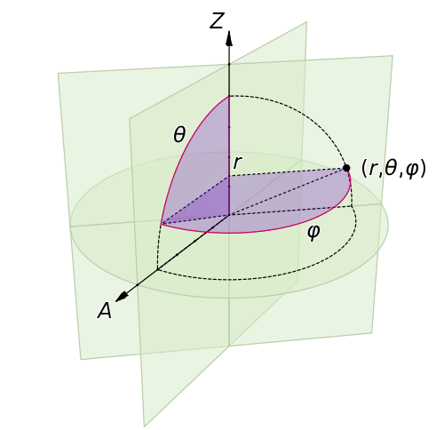
Theory of Spatial Hearing 101
People hear differently in left and right ear using 2 different cues:
  Direction
    (spherical coordinate system)
  Distance
Periphonic Sound Spatialization in Multi-User Virtual Environments – Florian Hollerweger

Slide 3
What is Sound Spatialization?
Illusion of sound from a 3-D environment
Can be electroacoustically synthesized
  Even in a multiple-user environment?
  YES, but requires higher level of accuracy!

Slide 4
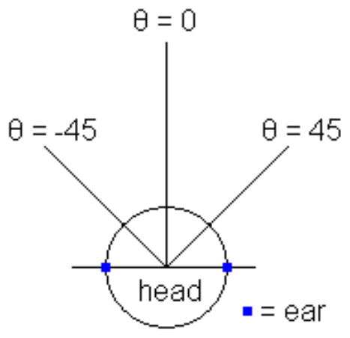
Our Sound Spatialization
2D
  Interaural Time Difference (ITD)
    Direction: Cartesian coordinate system
  Volume Difference
    Relative difference in distance
ITD calculation

Slide 5
Implementation
Mono audio input
Duplicate input and incorporate ITD (256bytes/ms of delay) before/after byte arrays
Merge the 2 mono audio stream into 1 stereo channel
Set relative volume
Output sound

Slide 6
Implementation ::
Single Audio Input
If using a WAV file: Remove header info
Read in file (byte[])
Duplicate file
Add ITD timeframe before/after the sample
Merge into one stereo channel
Set stereo volume
0 44

Slide 7
Implementation ::
Multiple Audio Sources
x2
x2
x2
x2
Mixer: set relative volume of each input and merge into 1 stereo channel
Mixer
Speakers

Slide 8
ITD/Distance Calculation
Problem: if it is recalculated for each tiny change in sound source location, app can slow down significantly
Solution: For each region, precalculate the ITD and Volume level and store the information in a file

Slide 9
ITD/Distance Calculation
ex: res/value.txt:
itd1, vdL1, vdR1
itd2, vdL2, vdR2
itd3, vdL3, vdR3
…
Itd20, vdL20, vdR20
1
5
9
13
17
2
6
10
14
18
3
7
11
15
19
4
8
12
16
20
Region 12 has the highest level of volume and no interaural time difference
Itdx (INT) = interaural time difference in milliseconds for region x
vdLx (FLOAT) = volume level for left ear for region x
vdRx (FLOAT) = volume level for right ear for region x

Slide 10
UI/Spatializer Interaction
When a new person is added to conference:
  Initialize audio source with its initial position
    AudioSS person1 = new AudioSS(px, py);
      (px, pv) = added person’s coordinate
      ITD and volume determined based on (px, py)
When the person is moved within the space:
  Update the ITD and Volume based on new position
    person1.moveTo(nx, ny);
      (nx, ny) = new position
      ITD and volume determined based on new positions

